Slide 1
WRES2203 Advanced Network Technology
Chapter 5
Multiarea OSPF

Slide 2
Contents
Introduction
LSA
Configuration
Advanced OSPF

Slide 3
Introduction
Single-area OSPF is useful in smaller networks where the web of router links is not complex, and paths to individual destinations are easily deduced.
However, if an area becomes too big, the following issues must be addressed:
  Large routing table
    OSPF does not perform route summarization by default. If the routes are not summarized, the routing table can become very large, depending on the size of the network.

Slide 4
Introduction
  Large link-state database (LSDB)
    LSDB covers the topology of the entire network, each router must maintain an entry for every network in the area, even if not every route is selected for the routing table.
  Frequent SPF algorithm calculations
    In a large network, changes are inevitable, so the routers spend many CPU cycles recalculating the SPF algorithm and updating the routing table.

Slide 5
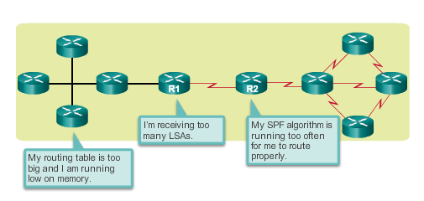
Introduction

Slide 6
Introduction
Multiarea OSPF is useful in larger network deployments to reduce processing and memory overhead.
Multiarea OSPF requires a hierarchical network design. The main area is called the backbone area (area 0) and all other areas must connect to the backbone area.
With hierarchical routing, routing still occurs between the areas (interarea routing); while many of the tedious routing operations, such as recalculating the database, are kept within an area.

Slide 7
Introduction
Advantages
  Smaller routing tables
    There are fewer routing table entries as network addresses can be summarized between areas.
  Reduced link-state update overhead
    Minimizes processing and memory requirements, because there are fewer routers exchanging LSAs.
  Reduced frequency of SPF calculations
    Localizes impact of a topology change within an area. For instance, it minimizes routing update impact, because LSA flooding stops at the area boundary.

Slide 8
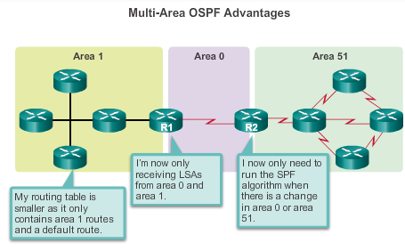
Introduction

Slide 9
Introduction
Multi-area OSPF is implemented in a two-layer area hierarchy:
Backbone (Transit) area
  An OSPF area whose primary function is the fast and efficient movement of IP packets.
  Backbone areas interconnect with other OSPF area types. The backbone area is also called OSPF area 0. Hierarchical networking defines area 0 as the core to which all other areas directly connect.
Regular (Non-backbone) area
  Connects users and resources. Regular areas are usually set up along functional or geographical groupings.

Slide 10
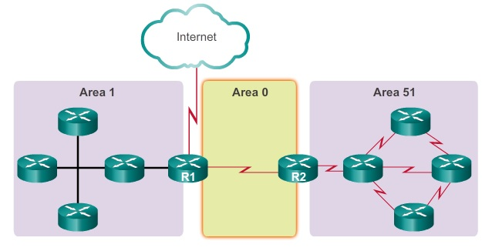
Introduction

Slide 11
Introduction
There are four different types of OSPF routers:
Internal router
  This is a router that has all of its interfaces in the same area.
  All internal routers in an area have identical LSDBs.
Backbone router
  This is a router in the backbone area. Generally, the backbone area is set to area 0.
Area Border Router (ABR)
  This is a router that has interfaces attached to multiple areas. It must maintain separate LSDBs for each area it is connected to, and can route between areas.

Slide 12
Introduction
Autonomous System Boundary Router (ASBR)
  This is a router that has at least one interface attached to an external internetwork (another autonomous system), such as a non-OSPF network.
  An ASBR can import non-OSPF network information to the OSPF network, and vice versa, using a process called route redistribution.

Slide 13
LSA
LSAs are the building blocks of the OSPF LSDB.
Individually, they act as database records and provide specific OSPF network details. In combination, they describe the entire topology of an OSPF network or area.
The implementation of multiarea OSPF must support the first five LSAs: LSA 1 to LSA 5.
Each router link is defined as an LSA type. Depending on the type, the link ID has different meanings. LSAs differ on how they are generated and propagated within the routing domain.

Slide 14
LSA
All routers advertise their directly connected OSPF-enabled links in a type 1 LSA and forward their network information to OSPF neighbors.
The LSA contains a list of the directly connected interfaces, link types, and link states.
Type 1 LSAs are also referred to as router link entries.
Type 1 LSAs are flooded only within the area in which they originated.
The type 1 LSA link ID is identified by the router ID of the originating router.

Slide 15
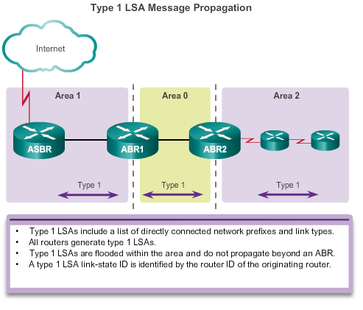
LSA

Slide 16
LSA
A type 2 LSA only exists for multiaccess and non-broadcast multiaccess (NBMA) networks
The type 2 LSA contains the router ID and IP address of the DR, along with the router ID of all other routers on the multiaccess segment.
The DR floods type 2 LSAs only within the area in which they originated. Type 2 LSAs are not forwarded outside of an area.
The link-state ID for type 2 LSA is the router-id of the DR that advertises it.

Slide 17
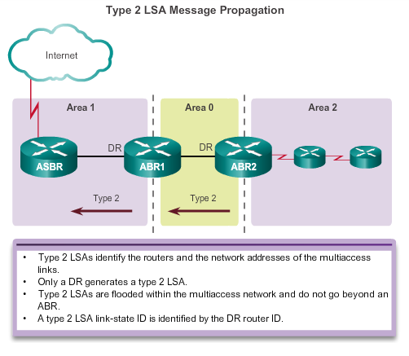
LSA

Slide 18
LSA
Type 3 LSAs are used by ABRs to advertise networks from other areas.
ABRs collect type 1 LSAs in the LSDB. After an OSPF area has converged, the ABR creates a type 3 LSA for each of its learned OSPF networks.
The link-state ID is set to the network address and the mask is also advertised.

Slide 19
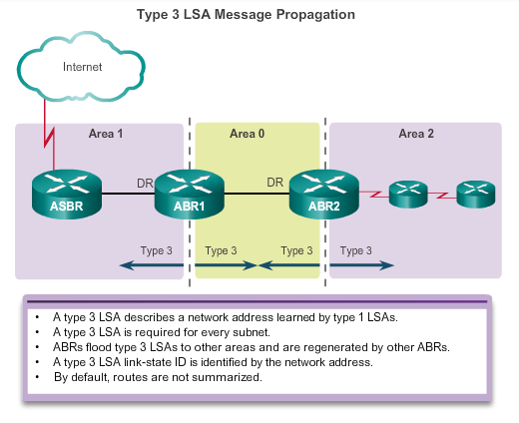
LSA

Slide 20
LSA
A type 4 summary LSA is generated by an ABR only when an ASBR exists within an area.
A type 4 LSA identifies the ASBR and provides a route to it. All traffic destined to an external autonomous system requires routing table knowledge of the ASBR that originated the external routes.
When ABR receives the type 1 LSA from ASBR. it builds a type 4 LSA, and then floods the type 4 LSA to the backbone (area 0).
Subsequent ABRs flood the type 4 LSA into other areas.
The link-state ID is set to the ASBR router ID.

Slide 21
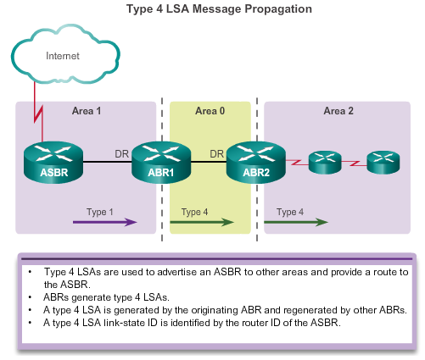
LSA

Slide 22
LSA
Type 5 external LSAs describe routes to networks outside the OSPF autonomous system.
Type 5 LSAs are originated by the ASBR and are flooded to the entire autonomous system. They are also referred to as autonomous system external LSA entries.
ABRs flood the type 5 LSA into other areas.
It is strongly recommended that manual route summarization be configured on the ASBR.
The link-state ID is the external network address.

Slide 23
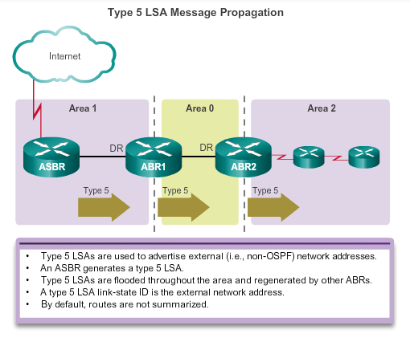
LSA

Slide 24
LSA
O - Router (type 1) and network (type 2) LSAs describe the details within an area.
O IA - Summary LSAs appear in the routing table as IA (Interarea routes).
O E1 or O E2 - External LSAs appear in the routing table marked as External Type 1 (E1) or External Type 2 (E2) routes.

Slide 25
LSA
Each router uses the SPF algorithm against the LSDB to build the SPF tree.
Calculate the best paths to destinations (intra-area) and add these entries to the routing table.
Calculate the best paths to the other areas within the internetwork. These best paths are the inter-area route entries (type 3 and type 4 LSAs)
Calculate the best paths to the external autonomous system (type 5) destinations.

Slide 26
Configuration
Four steps are required to implement multiarea OSPF.
Step 1. Gather the network requirements and parameters
Step 2. Define the OSPF parameters
  IP addressing plan
  OSPF areas
  Network topology
Step 3. Configure the multiarea OSPF implementation based on the parameters.
Step 4. Verify the multiarea OSPF implementation based on the parameters.

Slide 27
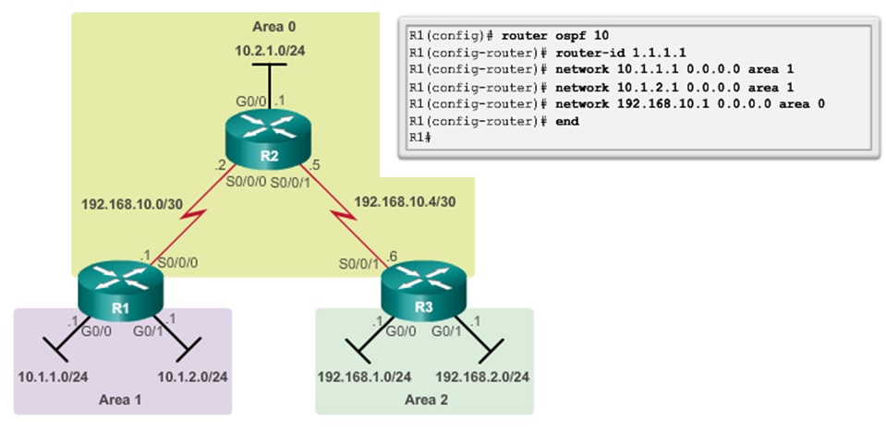
Configuration

Slide 28
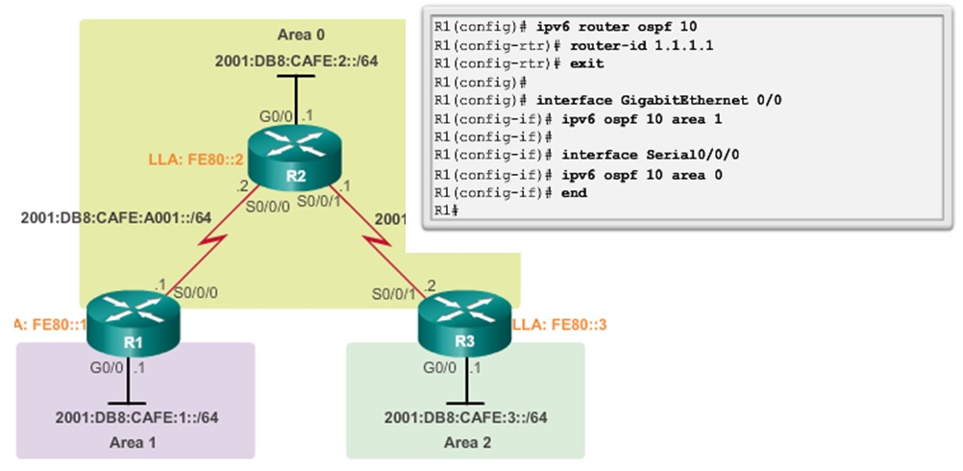
Configuration

Slide 29
Configuration
Summarization helps keep routing tables small. It involves consolidating multiple routes into a single advertisement, which can then be propagated into the backbone area.
Summarization also helps increase the network’s stability, because it reduces unnecessary LSA flooding.
This directly affects the amount of bandwidth, CPU, and memory resources consumed by the OSPF routing process.

Slide 30
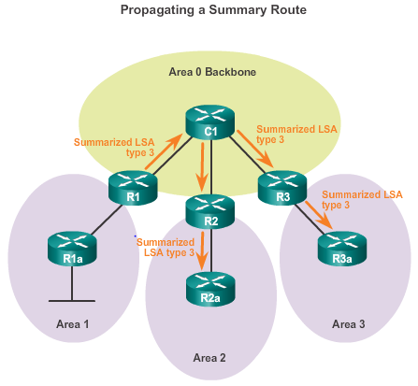
Configuration

Slide 31
Configuration
In OSPF, summarization can only be configured on ABRs or ASBRs. ABR routers summarize type 3 LSAs and ASBR routers summarize type 5 LSAs.
Inter-area Route Summarization
  Occurs on ABRs and applies to routes from within each area.
External Route Summarization
  Specific to external routes that are injected into OSPF via route redistribution.
  ASBRs summarize external routes.

Slide 32
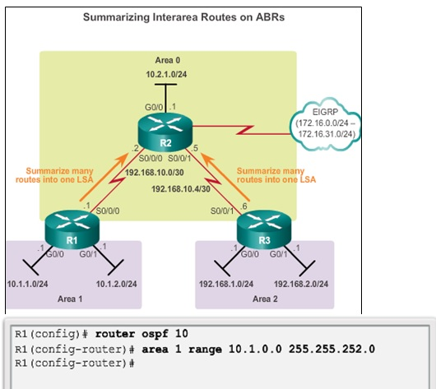
Configuration

Slide 33
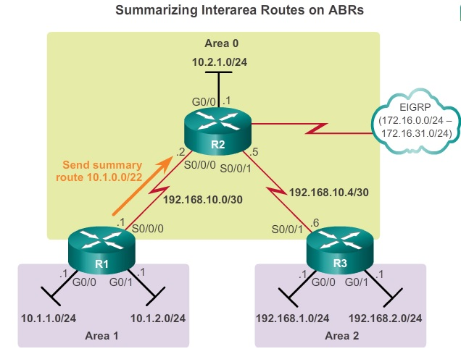
Configuration

Slide 34
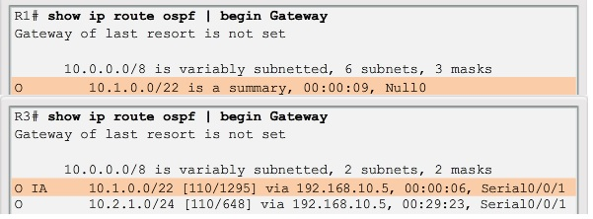
Configuration

Slide 35
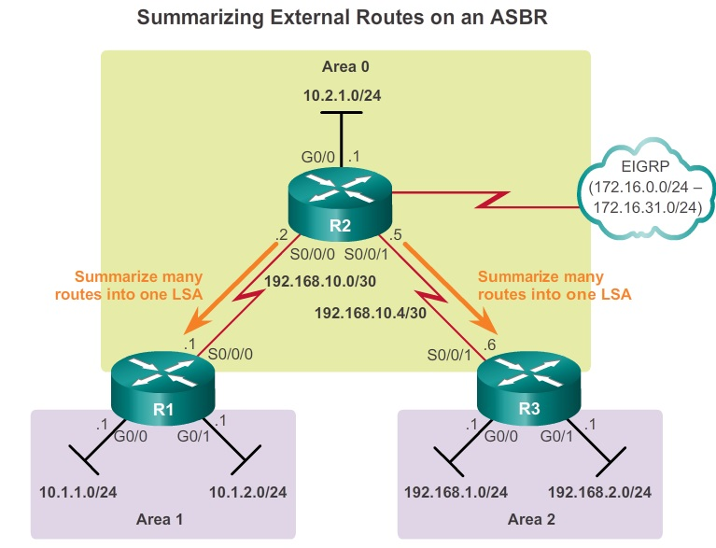
Configuration

Slide 36
Configuration
show ip protocols
show ip ospf
show ip ospf neighbor
show ip ospf database
show ip route ospf
show ip ospf interface
show ip ospf interface brief

Slide 37
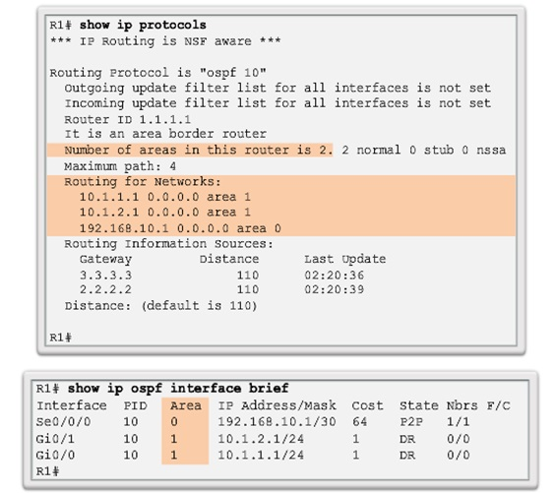
Configuration

Slide 38
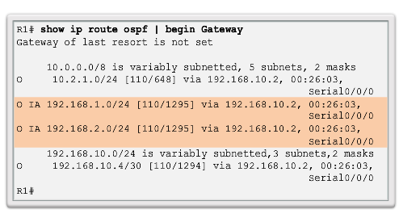
Configuration

Slide 39
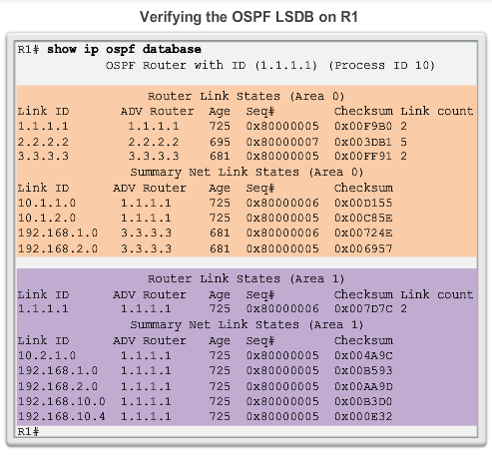
Configuration

Slide 40
Advanced OSPF
OSPF defines five network types:
  Point-to-point
    Two routers interconnected over a common link. No other routers are on the link.
  Broadcast multiaccess
    Multiple routers interconnected over an Ethernet network.
  Nonbroadcast multiaccess (NBMA)
    Multiple routers interconnected in a network that does not allow broadcasts, such as Frame Relay.

Slide 41
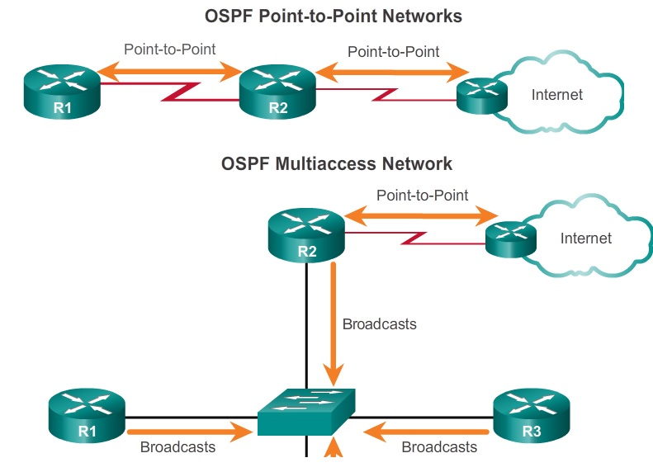
Advanced OSPF

Slide 42
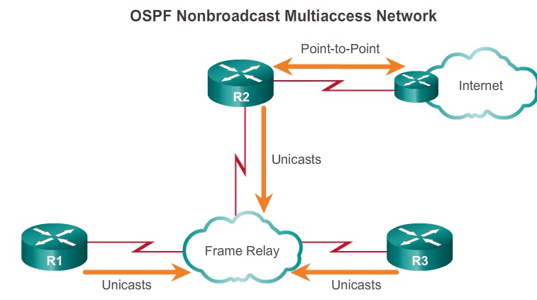
Advanced OSPF

Slide 43
Advanced OSPF
  Point-to-multipoint
    Multiple routers interconnected in a hub-and-spoke topology over an NBMA network. Often used to connect branch sites (spokes) to a central site (hub).
  Virtual links
    Special OSPF network used to interconnect distant OSPF areas to the backbone area.

Slide 44
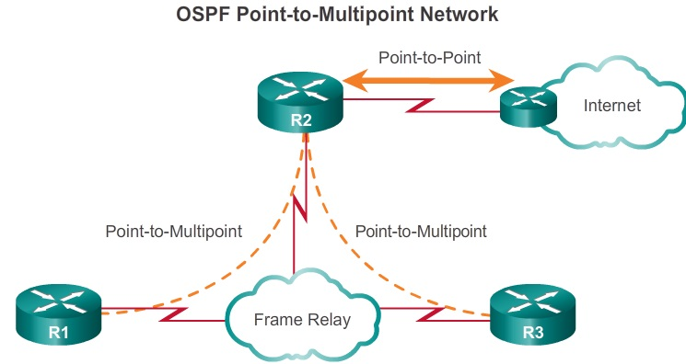
Advanced OSPF

Slide 45
Advanced OSPF
Multiaccess networks can create two challenges for OSPF regarding the flooding of LSAs:
Creation of multiple adjacencies
  Ethernet networks could potentially interconnect many OSPF routers over a common link. This would lead to an excessive number of LSAs exchanged between routers on the same network.
Extensive flooding of LSAs
  Link-state routers flood their link-state packets when OSPF is initialized, or when there is a change in the topology. This flooding can become excessive.

Slide 46
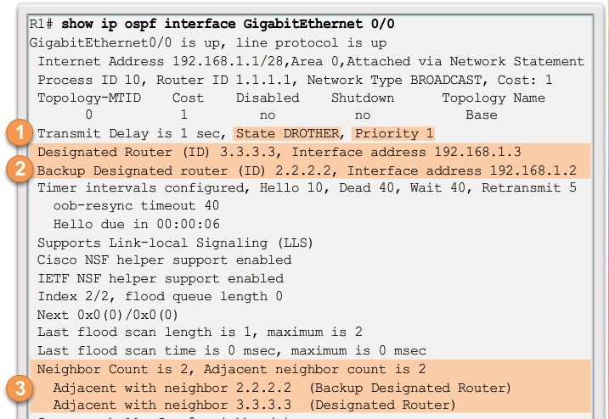
Advanced OSPF

Slide 47
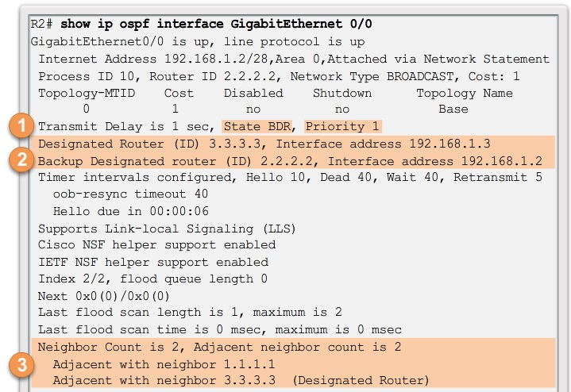
Advanced OSPF

Slide 48
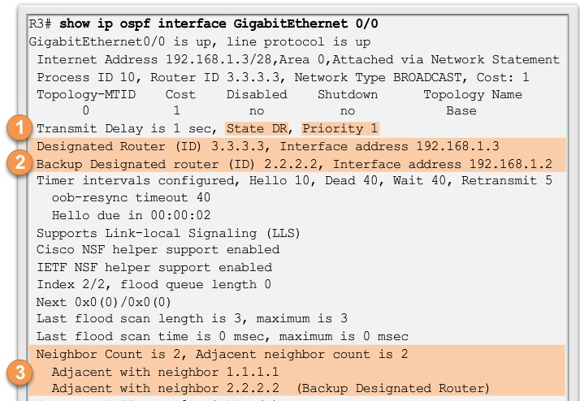
Advanced OSPF

Slide 49
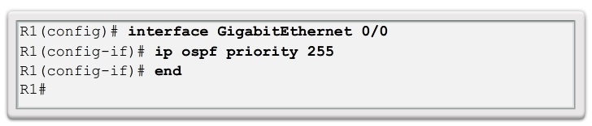
Advanced OSPF
The routers in the network elect the router with the highest interface priority as the DR. The router with the second highest interface priority is elected as the BDR.
The priority can be configured to be any number between 0 – 255.

Slide 50
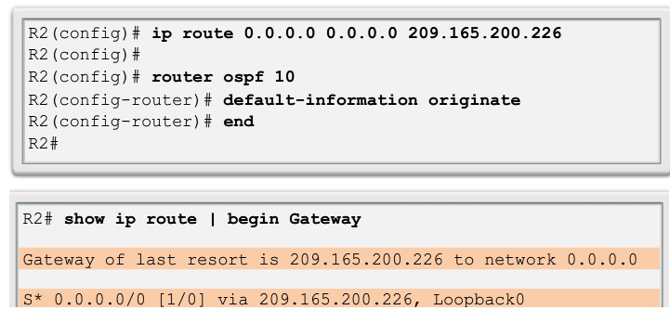
Advanced OSPF
With OSPF, the router connected to the Internet is used to propagate a default route to other routers in the OSPF routing domain.
This router is sometimes called the edge, the entrance, or the gateway router.

Slide 51
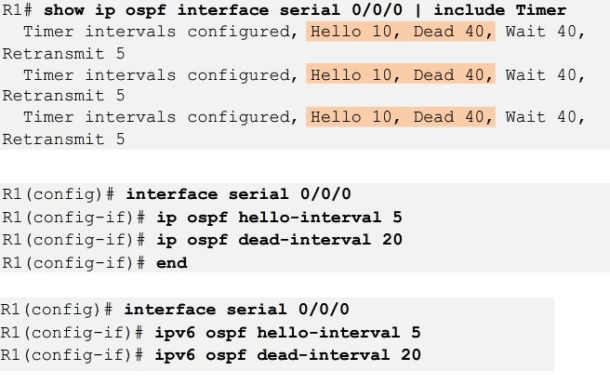
Advanced OSPF
The OSPF Hello and Dead intervals are configurable on a per-interface basis.
The OSPF intervals must match or a neighbor adjacency does not occur.

Slide 52
Advanced OSPF
OSPF supports 3 types of authentication:
  Null
    This is the default method and means that no authentication is used for OSPF.
  Simple password authentication
    This is also referred to as plaintext authentication because the password in the update is sent in plaintext over the network.
  MD5 authentication
    MD5 authentication provides higher security because the password is never exchanged between peers. Instead it is calculated using the MD5 algorithm. Matching results authenticate the sender.

Slide 53
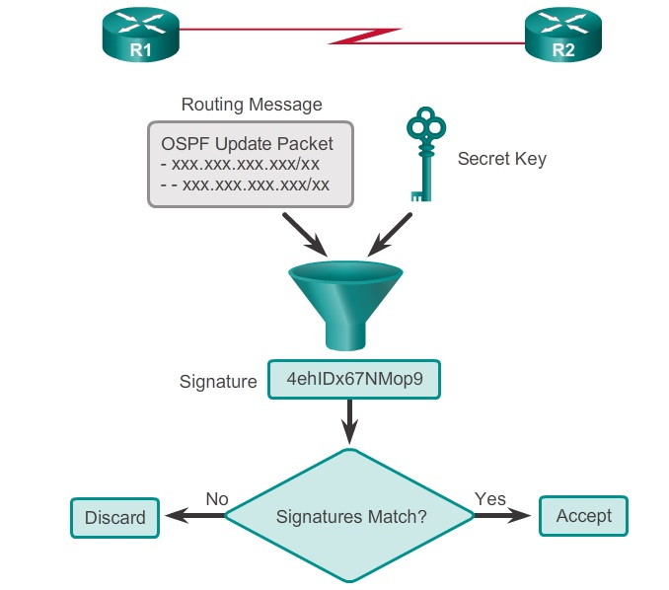
Advanced OSPF

Slide 54
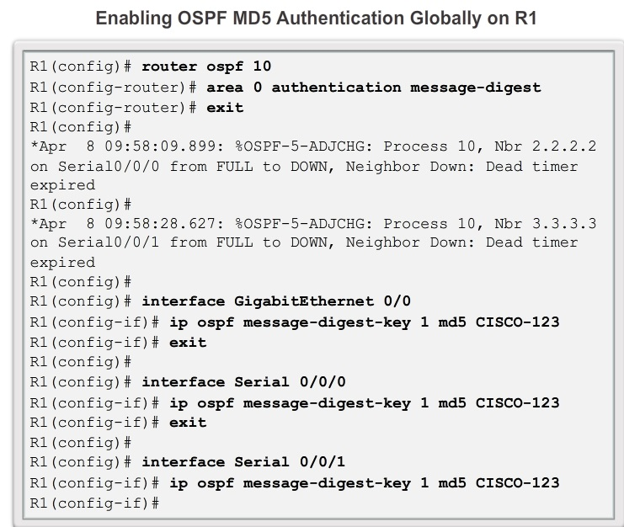
Advanced OSPF

Slide 55
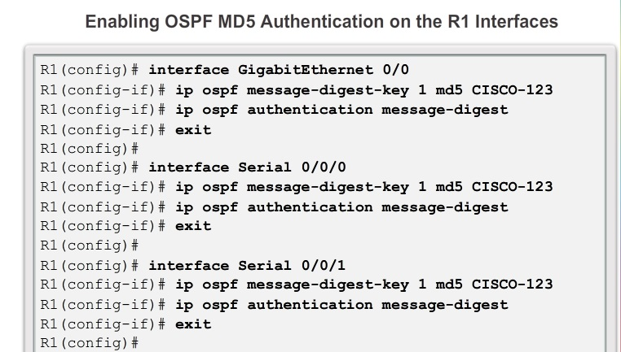
Advanced OSPF

Slide 56
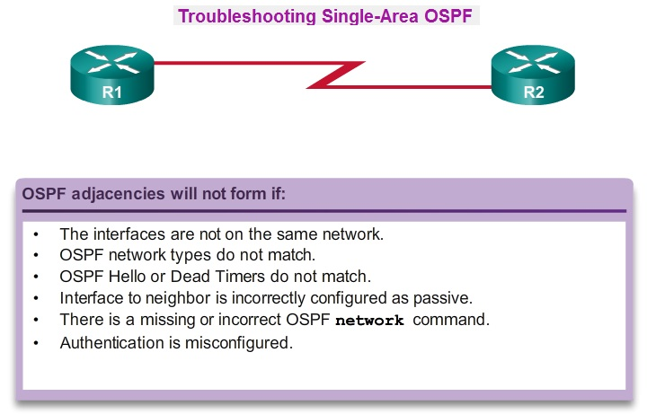
Advanced OSPF

Slide 57
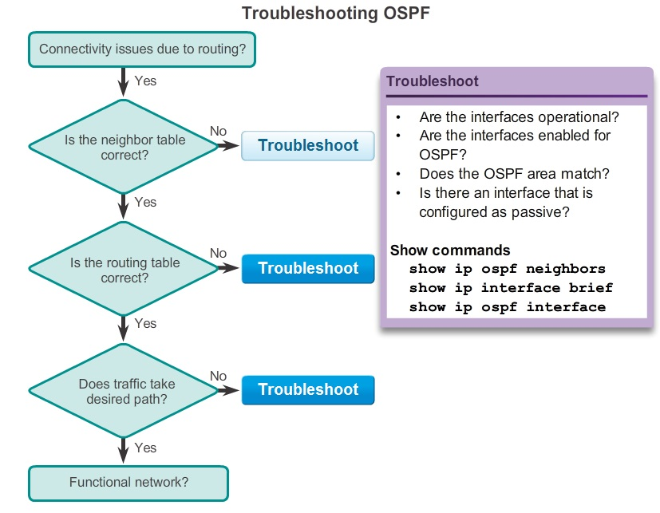
Advanced OSPF

